Slide 1
Deep Learning from Scratch
Theory + Practical
FAHAD HUSSAIN
MCS, MSCS, DAE(CIT)
Computer Science Instructor of well known international Center
Also, Machine Learning and Deep learning Practitioner
For further assistance, code and slide https://fahadhussaincs.blogspot.com/
YouTube Channel : https://www.youtube.com/fahadhussaintutorial

Slide 2
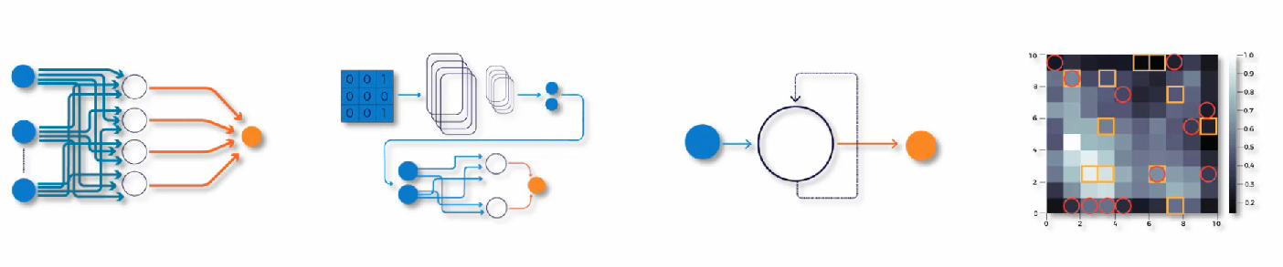
Boltzmann Machine or Boltzmann distribution
ANN CNN RNN SOM
For further assistance, code and slide https://fahadhussaincs.blogspot.com/
YouTube Channel : https://www.youtube.com/fahadhussaintutorial

Slide 3
Boltzmann Machine
A Boltzmann Machine is a network of symmetrically connected, neuron- like units that make stochastic decisions about whether to be on or off. Boltz- mann machines have a simple learning algorithm that allows them to discover interesting features in datasets composed of binary vectors.
For further assistance, code and slide https://fahadhussaincs.blogspot.com/
YouTube Channel : https://www.youtube.com/fahadhussaintutorial

Slide 4
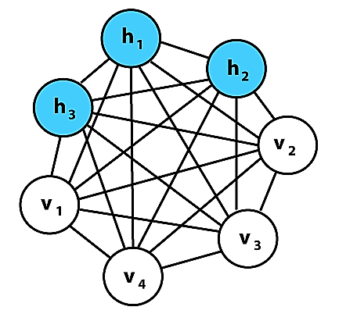
Boltzmann Machine or Boltzmann distribution
For further assistance, code and slide https://fahadhussaincs.blogspot.com/
YouTube Channel : https://www.youtube.com/fahadhussaintutorial

Slide 5
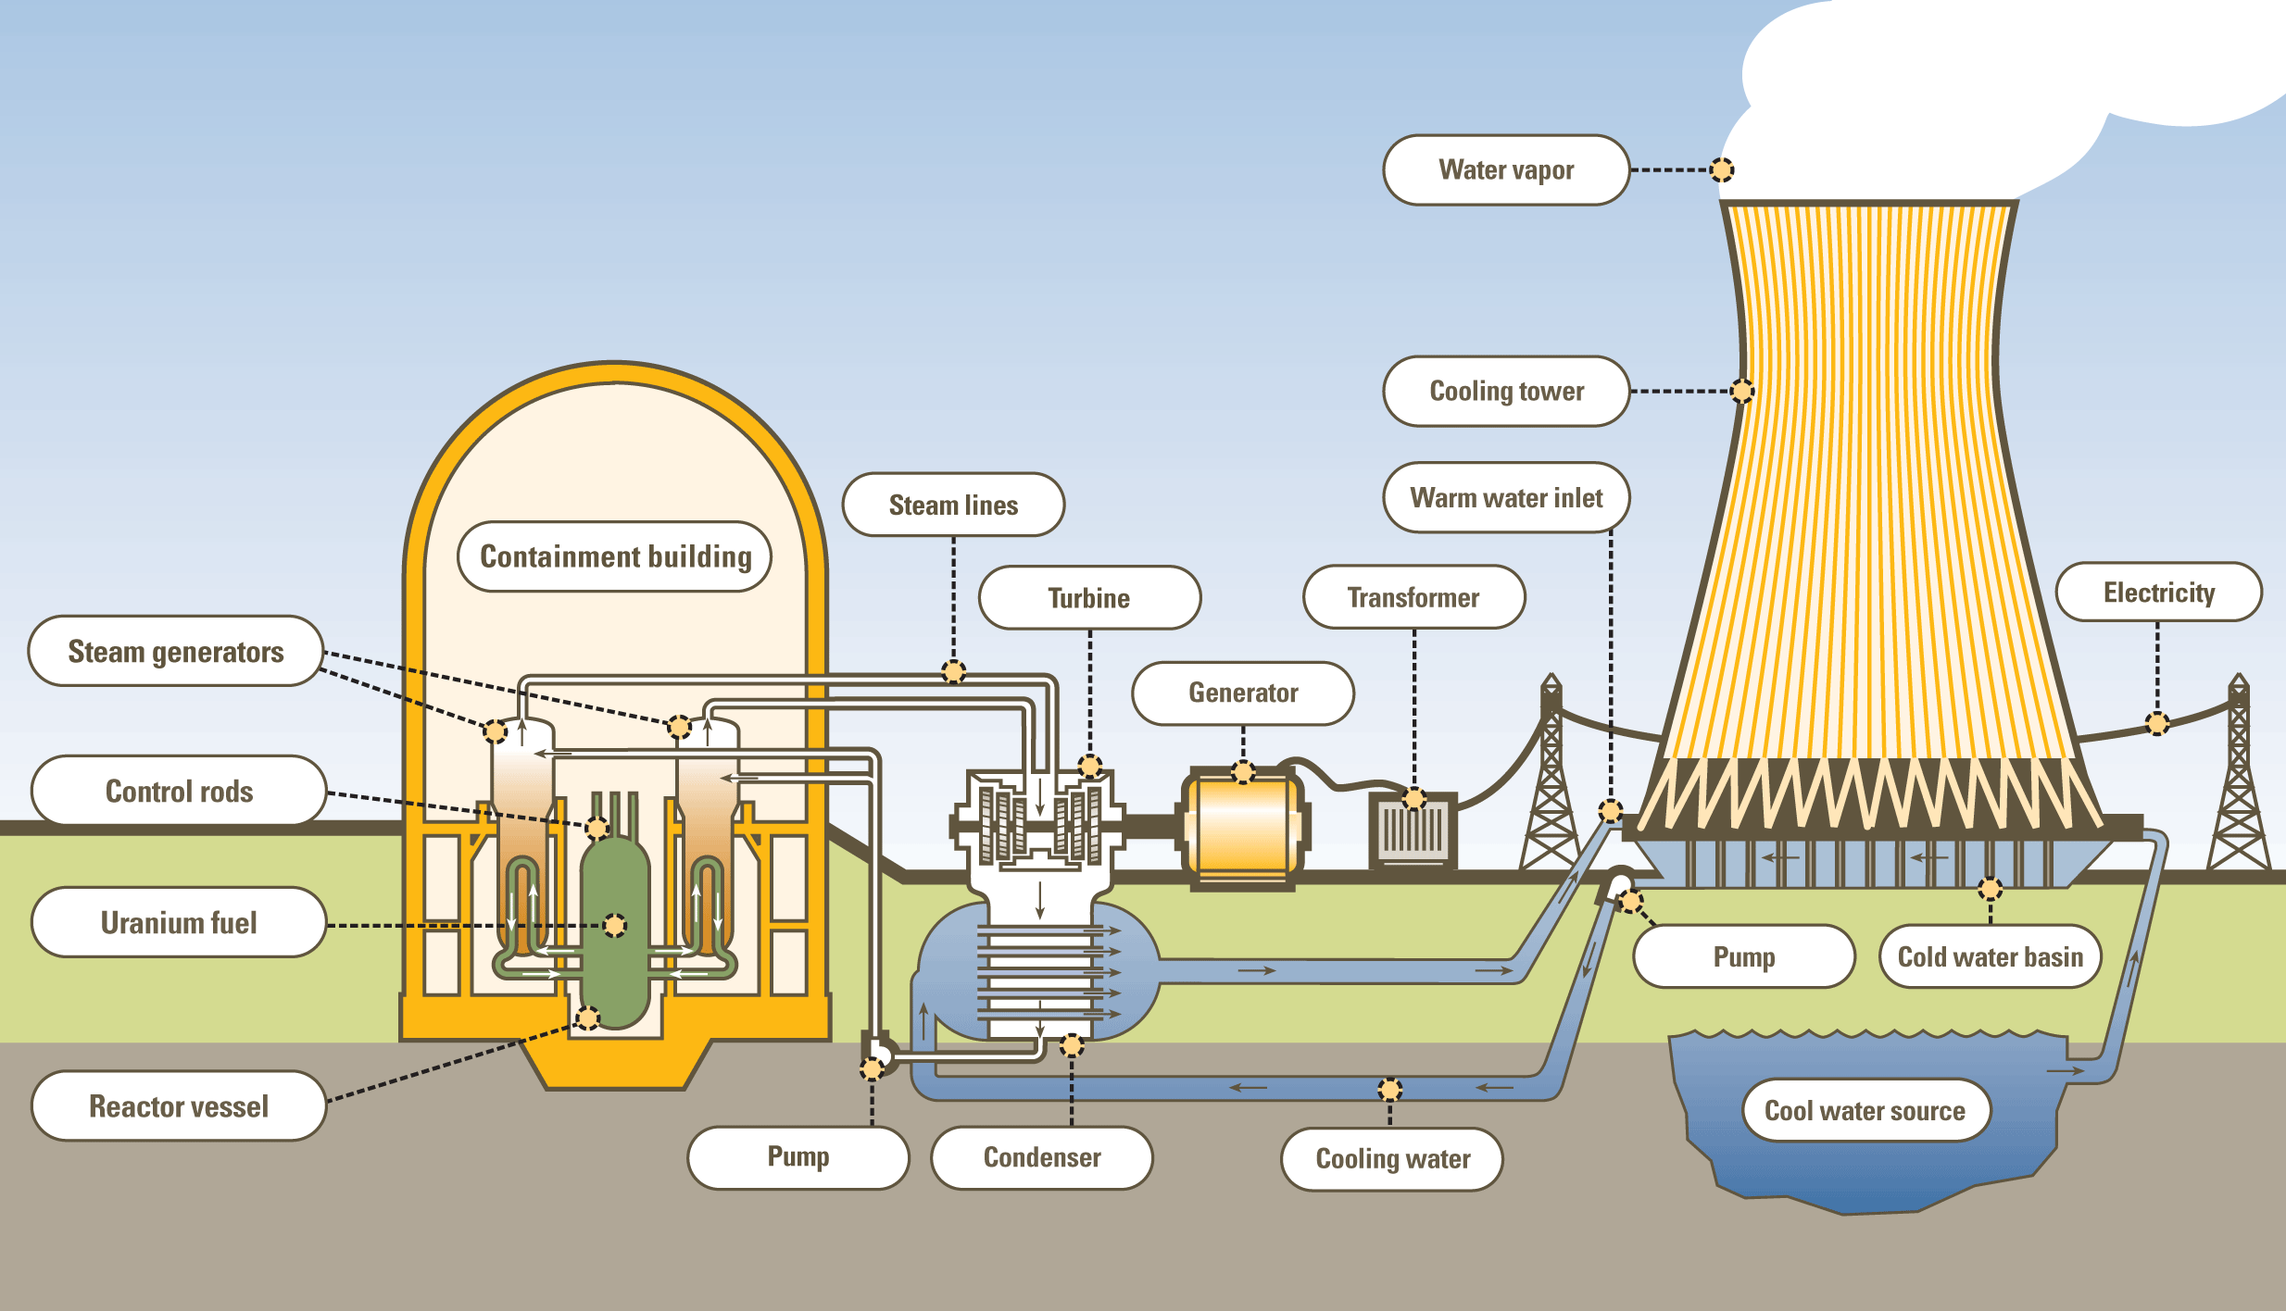
Boltzmann Machine or Boltzmann distribution
For further assistance, code and slide https://fahadhussaincs.blogspot.com/
YouTube Channel : https://www.youtube.com/fahadhussaintutorial

Slide 6
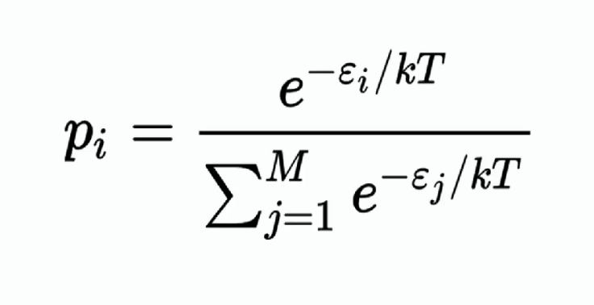
Boltzmann distribution and Factor
It is a probability measure that gives the probability that a system will be in a certain state as a function of that state energy and the temperature of the state.
For further assistance, code and slide https://fahadhussaincs.blogspot.com/
YouTube Channel : https://www.youtube.com/fahadhussaintutorial

Slide 7
Boltzmann Machine or Boltzmann distribution
For further assistance, code and slide https://fahadhussaincs.blogspot.com/
YouTube Channel : https://www.youtube.com/fahadhussaintutorial

Slide 8
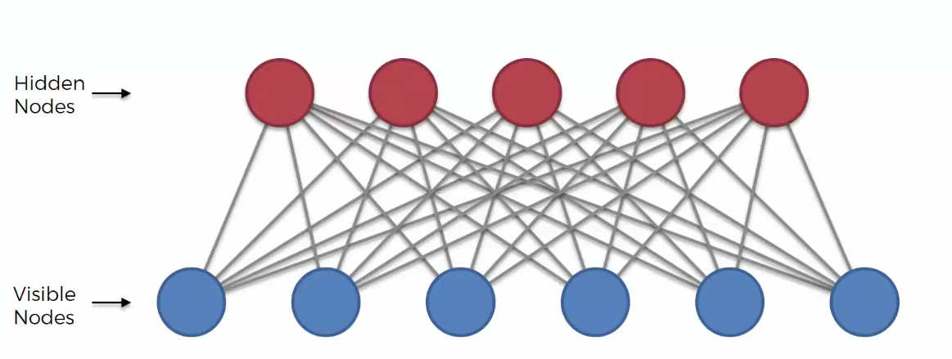
Restricted Boltzmann Machine
A restricted Boltzmann machine (RBM) is a generative stochastic artificial neural network that can learn a probability distribution over its set of inputs.
Restricted Boltzmann Machine is an undirected graphical model that plays a major role in Deep Learning Framework in recent times. It was initially introduced as Harmonium in 1986 and it gained big popularity in recent years in the context of the Netflix Prize where Restricted Boltzmann Machines achieved state of the art performance in collaborative filtering and have beaten most of the competition.
It is an algorithm which is useful for dimensionality reduction, classification, regression, collaborative filtering, feature learning, and topic modeling.
For further assistance, code and slide https://fahadhussaincs.blogspot.com/
YouTube Channel : https://www.youtube.com/fahadhussaintutorial

Slide 9
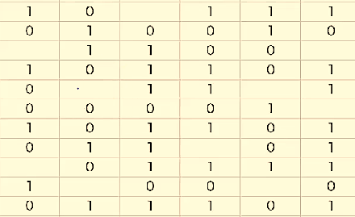
Restricted Boltzmann Machine
Working example as recommendation system
Drama Love Story Action Award Winning Khan_Movie
Movie1 Movie2 Movie3 Movie4 Movie5 Movie6
For further assistance, code and slide https://fahadhussaincs.blogspot.com/
YouTube Channel : https://www.youtube.com/fahadhussaintutorial

Slide 10
Restricted Boltzmann Machine
Drama Love Story Action Award Winning Khan_Movie
Movie1 Movie2 Movie3 Movie4 Movie5 Movie6
For further assistance, code and slide https://fahadhussaincs.blogspot.com/
YouTube Channel : https://www.youtube.com/fahadhussaintutorial

Slide 11
Thanks
For further assistance, code and slide https://fahadhussaincs.blogspot.com/
YouTube Channel : https://www.youtube.com/fahadhussaintutorial

Slide 12
Restricted Boltzmann Machine
Drama Love Story Action Award Winning Khan_Movie
Movie1 Movie2 Movie3 Movie4 Movie5 Movie6
For further assistance, code and slide https://fahadhussaincs.blogspot.com/
YouTube Channel : https://www.youtube.com/fahadhussaintutorial

Slide 13
Gibbs sampling and contrastive divergence
For further assistance, code and slide https://fahadhussaincs.blogspot.com/
YouTube Channel : https://www.youtube.com/fahadhussaintutorial

Slide 14
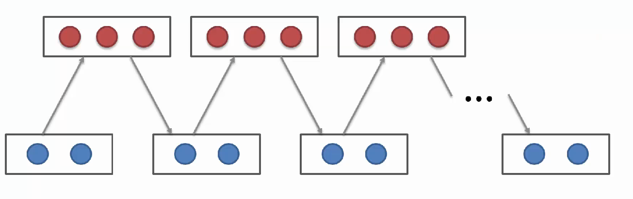
Gibbs sampling and contrastive divergence
For further assistance, code and slide https://fahadhussaincs.blogspot.com/
YouTube Channel : https://www.youtube.com/fahadhussaintutorial

Slide 15
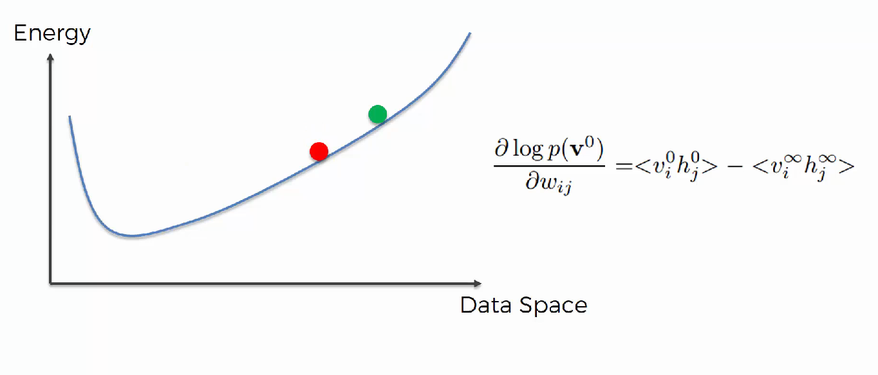
Gibbs sampling and contrastive divergence
In term of curve
For further assistance, code and slide https://fahadhussaincs.blogspot.com/
YouTube Channel : https://www.youtube.com/fahadhussaintutorial

Slide 16
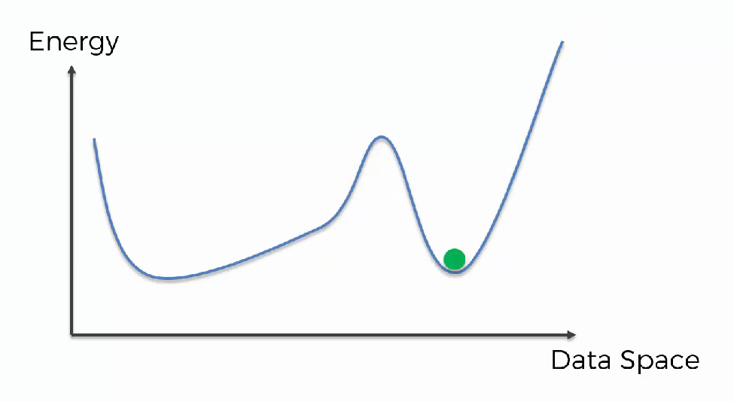
Gibbs sampling and contrastive divergence
In term of curve
For further assistance, code and slide https://fahadhussaincs.blogspot.com/
YouTube Channel : https://www.youtube.com/fahadhussaintutorial

Slide 17
Advance Topic which is related to RBM:
Deep Boltzmann Machines
and
Deep Belief Networks
Thanks
Additional Link:
http://deeplearning.net/tutorial/rbm.html#rbm
A fast learning algorithm for deep belief nets
Article
An Introduction to Restricted Boltzmann Machines
For further assistance, code and slide https://fahadhussaincs.blogspot.com/
YouTube Channel : https://www.youtube.com/fahadhussaintutorial

